Slide 1

Implementation of the Water Resources Classification System and Determination of the Resource Quality Objectives for Significant Water Resources in the Letaba Catchment
9: Preliminary operational scenarios
31 October 2013
Presented by:
Pieter van Rooyen

Slide 2
Letaba NWRCS steps
1: Delineate units of analysis and describe the status quo
2: Initiation of stakeholder process and catchment visioning
3: Quantify EWRs and changes in EGSA
7: Gazette class configuration
4: Identification and evaluation of scenarios within IWRM
5: Stakeholder process
6: Resource Quality Objectives (EcoSpecs & water quality (user))
Scenario Analysis: Where does it fit in?

Slide 3
What are scenarios?
Scenarios, in context of water resource management and planning are plausible definitions (settings) of all the factors (variables) that influence the water balance and water quality in a catchment and the system as a whole

Slide 4
What are scenarios used for?
Different levels of water use and protection are evaluated with the aim to find a balanced scenario
Water Resource Classification is the process to evaluate and recommend what that balance scenario entails

Slide 5
Evaluation of Scenarios
Entry
Scenario Description
Assign attributes to EWR nodes
Water
Availability Analysis
Estimate Consequences
Rank and
optimise
Formulate Alternative Scenarios
Select Scenario Subset
Stakeholder Evaluation
Ecological
EGSA
Economical
Non-Ecological Water Quality

Slide 6
Catchment Analysis
Catchment Resource Availability
Ecological
Water Requirements
Socio-Economic
Water Requirements
Protection
Use
Management Class
(Decision)

Slide 7
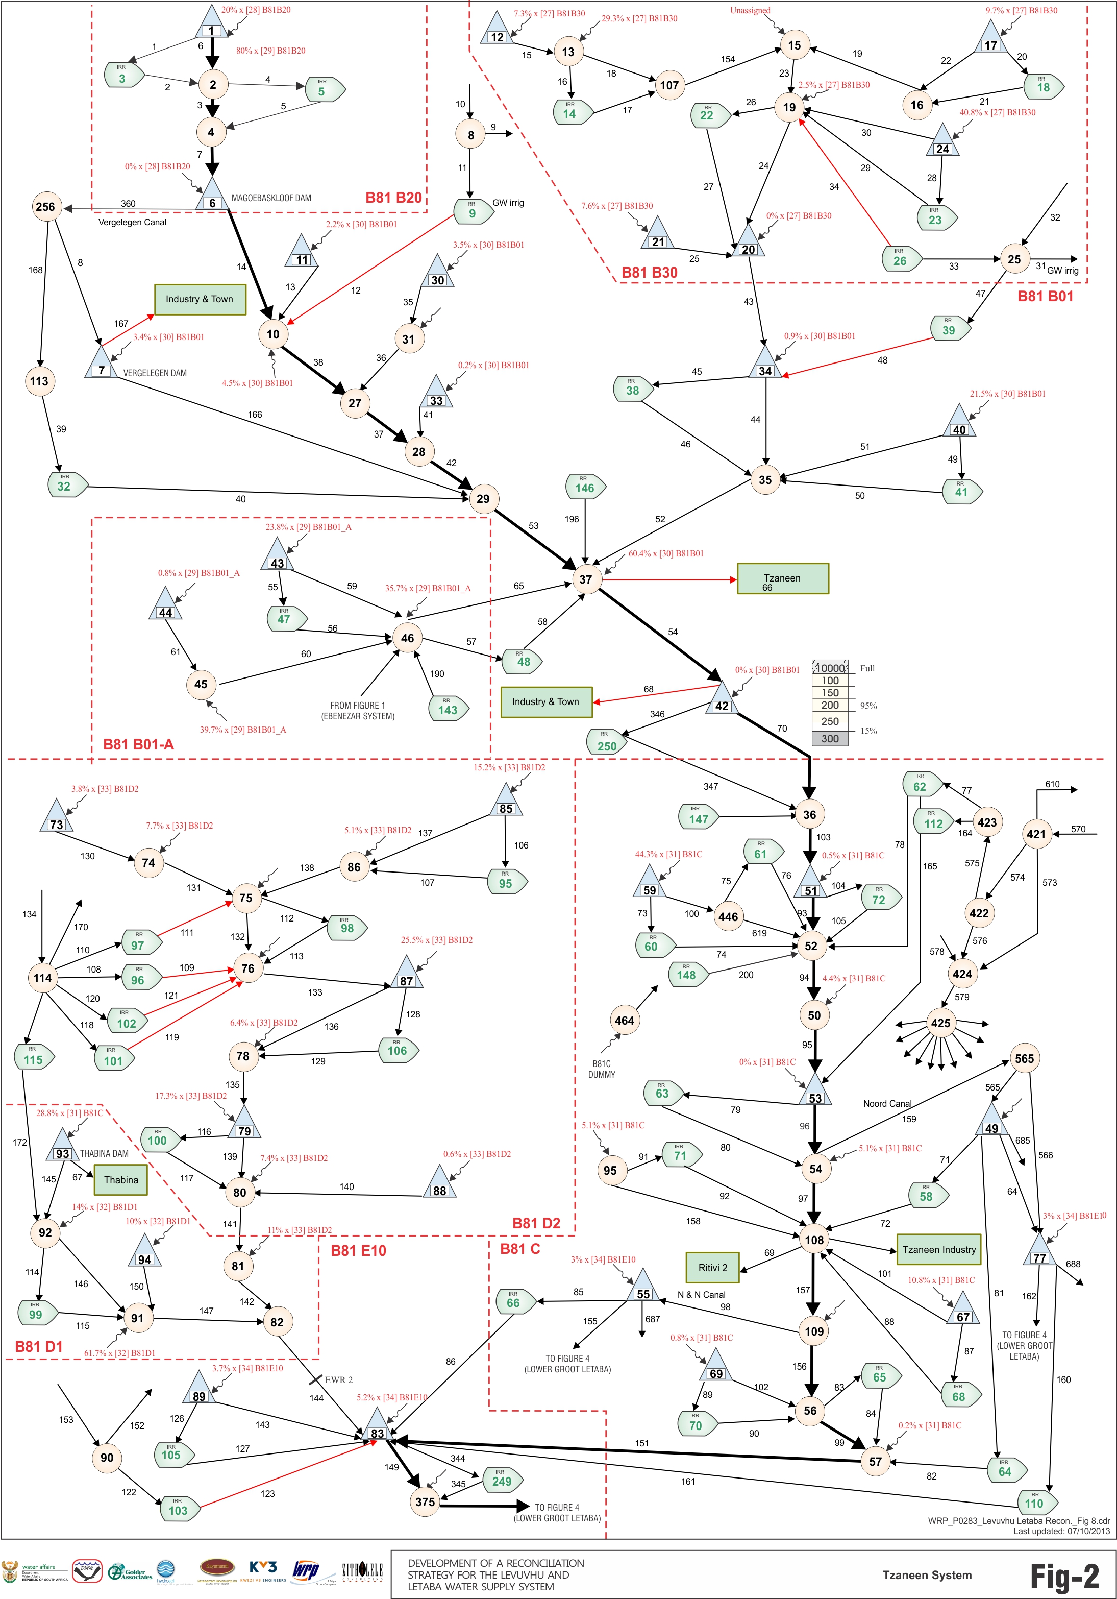
Magoebaskloof
Water Resources Network Model
Vergelegin
Hans Merensky
Tzaneen
Thabina
Noord Canal
NN Canal

Slide 8
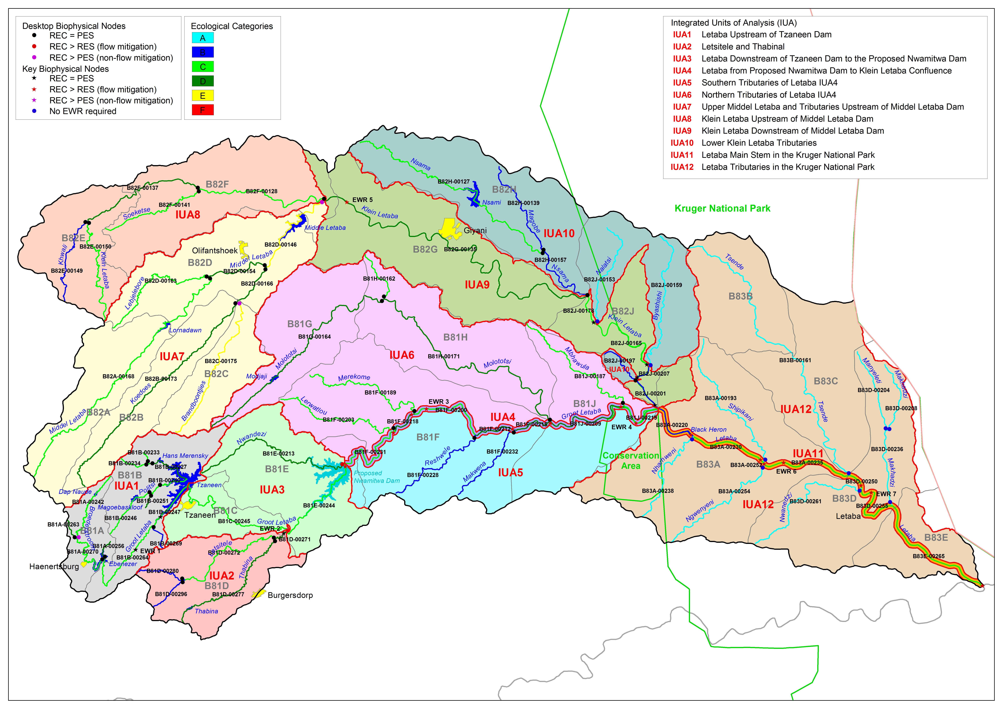

Slide 9
Groot Letaba Catchment Options
(Reconciliation Strategy: April 2012)
GL1: Raising of Tzaneen Dam.
GL2: Construction of Nwamitwa Dam.
GL3: Bulk Water Supply Infrastructure from Nwamitwa Dam.
GL5: Artificial recharge at Mulele on Molototsi River.
GL6: Groundwater regional scheme in conjunction with surface scheme.

Slide 10
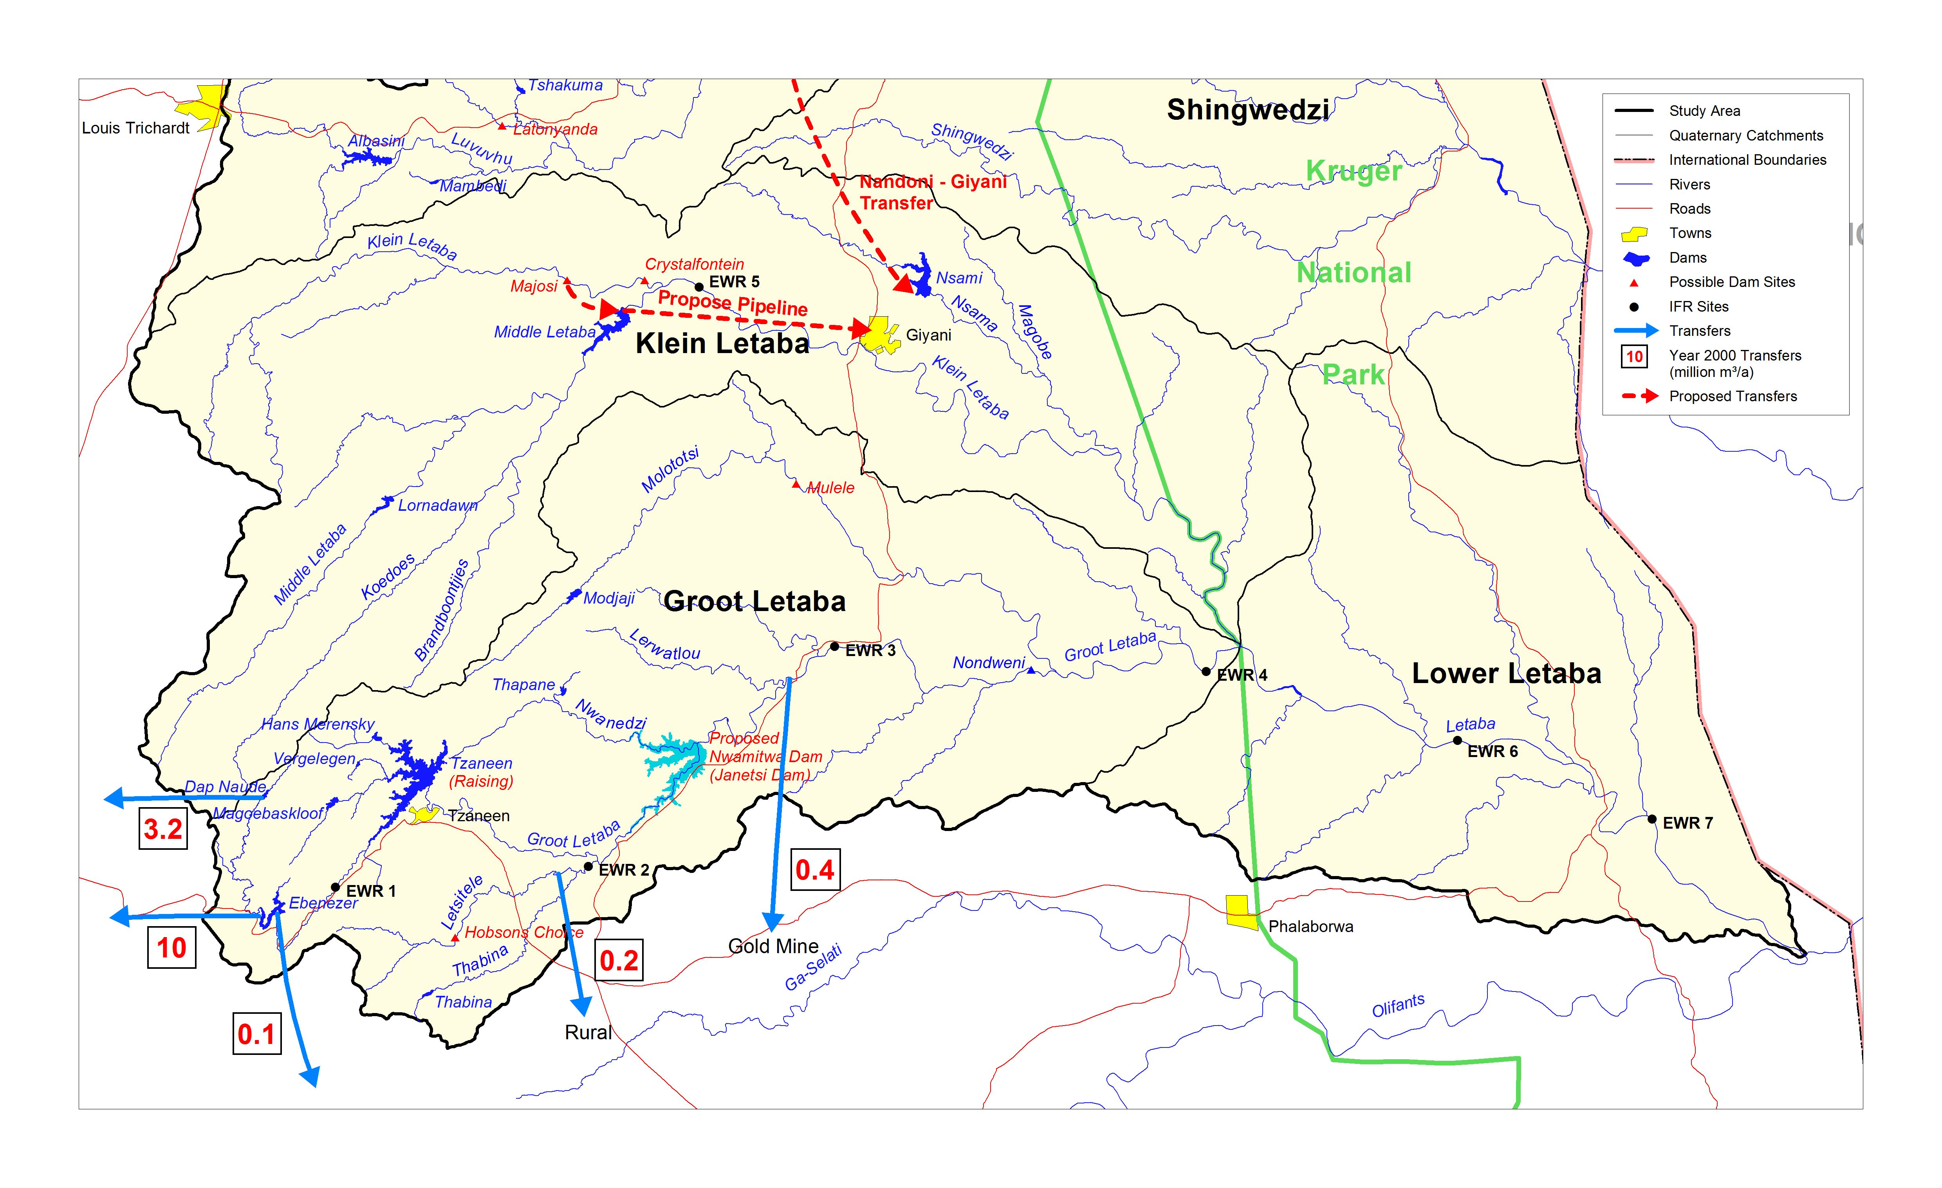
Groot and Klein Letaba

Slide 11
Middel & Klein Letaba Catchment
(Reconciliation Strategy: April 2012)
MKL1: Water Conservation & Water Demand Management.
MKL2: Development of groundwater resource.
MKL3: Replacement of Middel Letaba canal with pipeline.
MKL4: Transfer Scheme from Nandoni Dam.
MKL5: Construction of new dam on Klein Letaba River:
  Majosi Dam
  Crystalfontein Dam

Slide 12
Middel and Klein Letaba

Slide 13
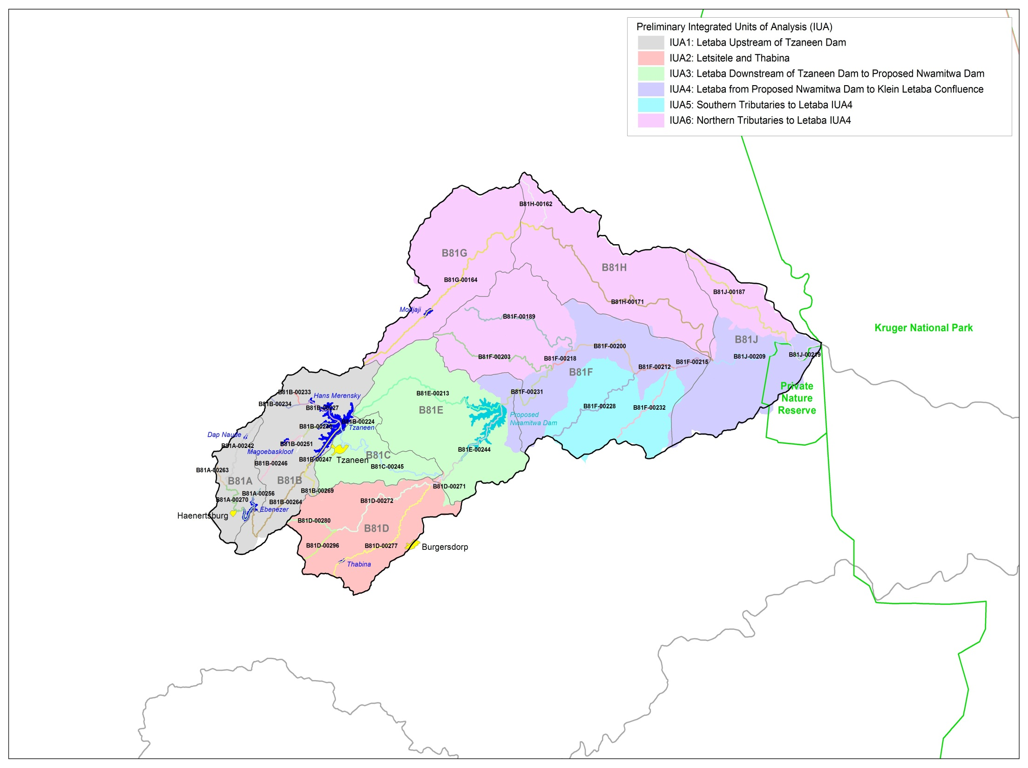
Scenarios in context of IUAs
Letaba u/s Tzaneen Dam
Approved: Groot Letaba River Water Development Project : Raising of Tzaneen Dam
Applications:
  Abstraction to Polokwane
  Politsi Scheme
Molatotsi River
Option for evaluation, Artificial aquifer recharge at Mulele .
Letaba d/s Tzaneen Dam to Proposed Nwamitwa Dam
Approved: Groot Letaba River Water Development Project : Nwamitwa Dam
Letsitele and Thabina
Option for evaluation, Letsitele River Valley Dam

Slide 14
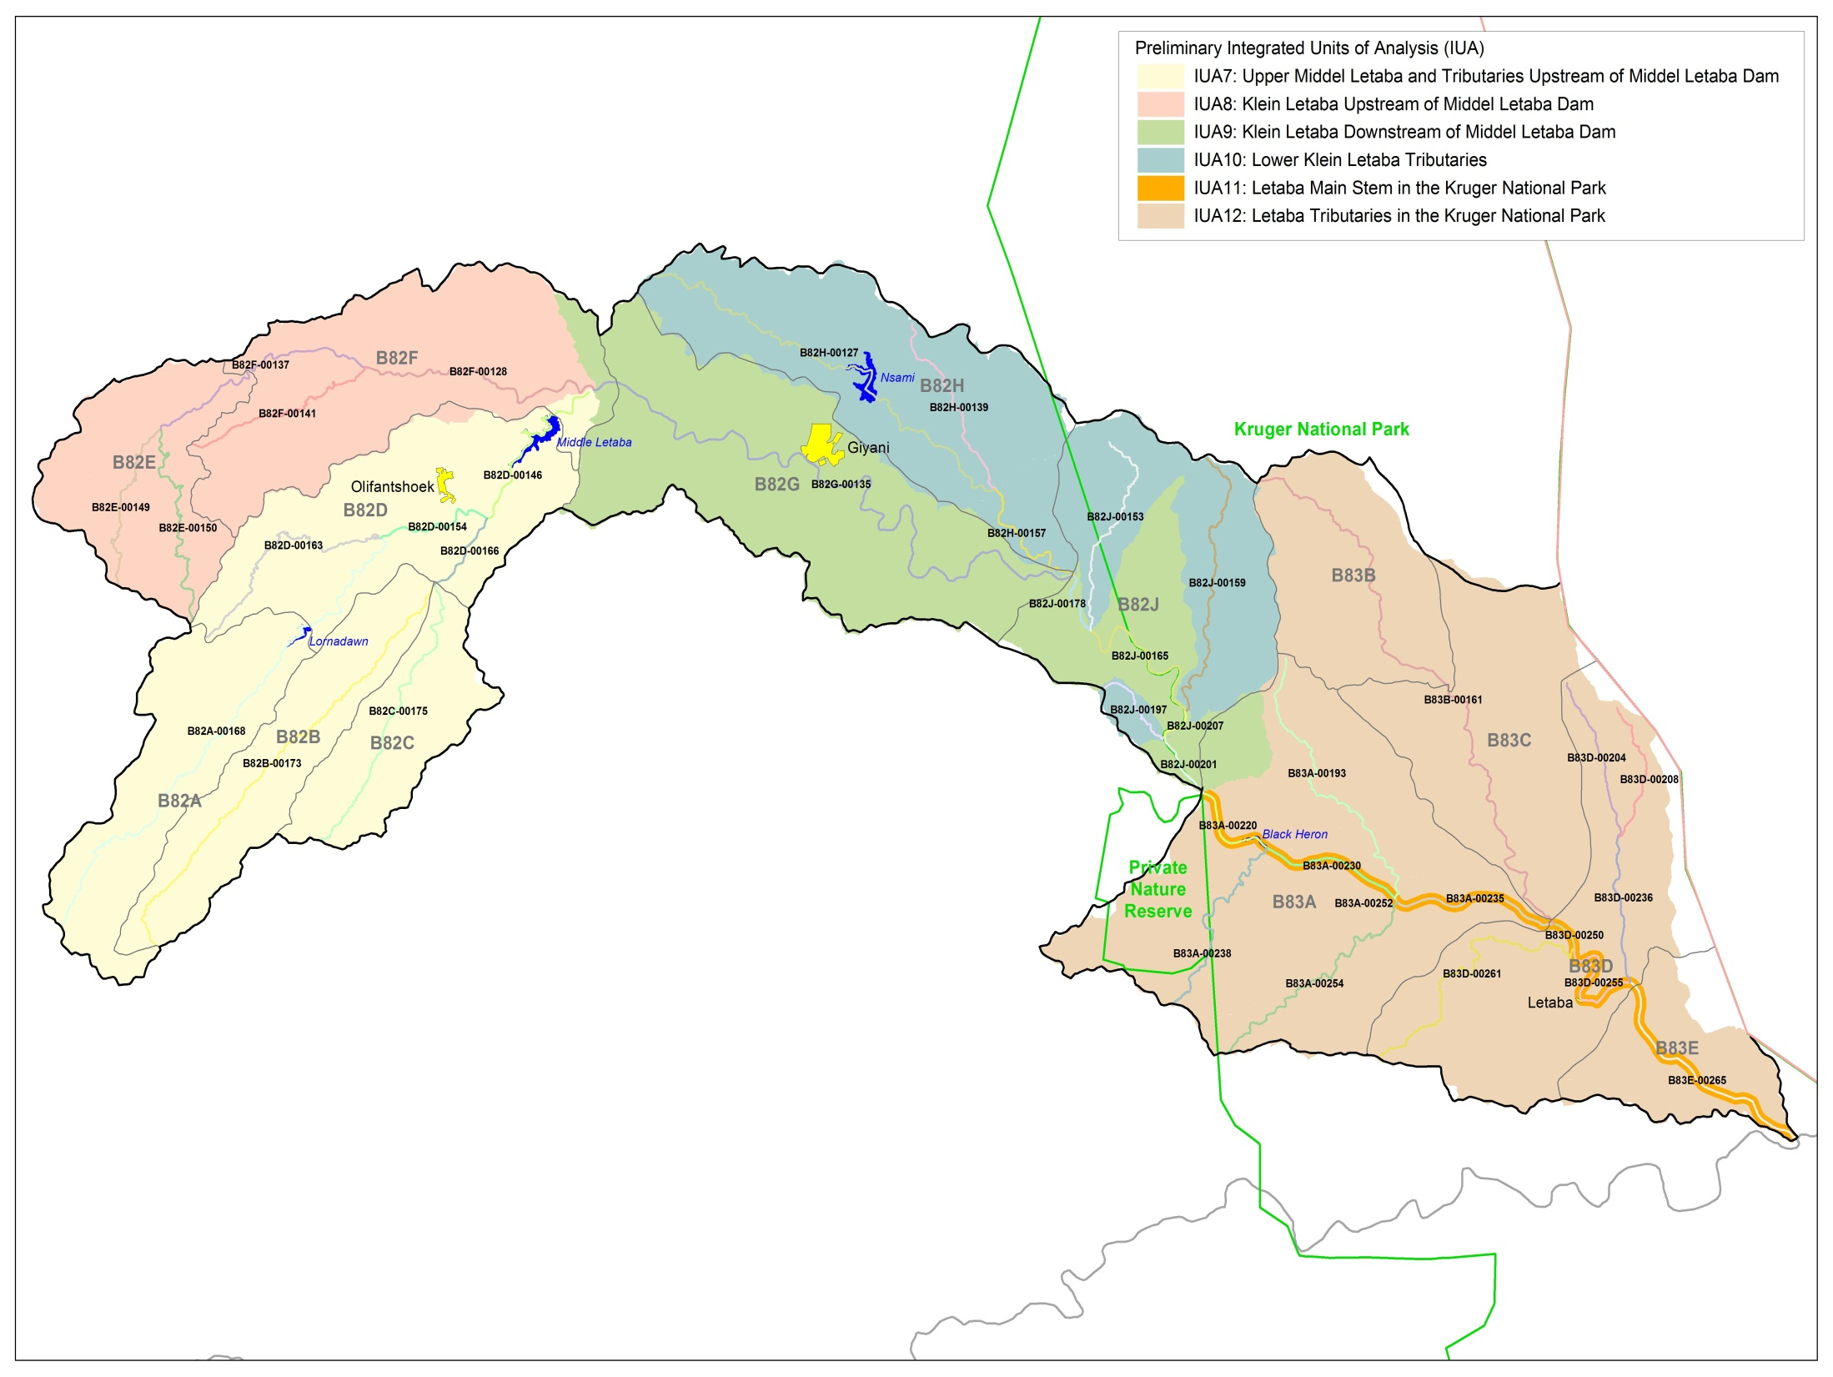
Klein Letaba u/s Middel Letaba Dam
Option for evaluation: Crystalfontein Dam and conveyance infrastructure
Klein Letaba d/s Middel Letaba Dam
Pipeline to replace canal, reducing losses
Scenarios in context
of IUAs

Slide 15
Summary of scenarios
Scenario | Groot Letaba River Drivers |  |  |  |  |  |  | Middel & Klei Letaba Drivers |  |  | EWR Drivers
 | Raised Tzaneen Dam | Nwamitwa Dam & supply infrastructure | Letsitele River Valley Dam | Mulele Dam GW recharge | Additional allocation to Polokwane | Max GW use | Court order releases from Dap Naude | Crystal-fontein Dam | Max GW use | Transfer from Nandoni Dam | KNP EWR of 0.6 | EWR 1,2,3,4,5,7 (low flows) REC included | EWR total flow | EWR low flows
1 (PD) |  |  |  |  |  |  |  |  |  |  | •
2 |  |  |  |  |  |  |  |  |  |  |  | •
3 | • |  |  |  |  |  |  |  |  | • | •
4 | • | • |  |  | • | • | • |  | • | • | •
5 | • | • | • | • | • | • | • | • | • | • | •
6 | • | • | • | • | • | • | • | • | • | • | •

Slide 16
Summary of scenarios
Scenario | Groot Letaba River Drivers |  |  |  |  |  |  | Middel & Klei Letaba Drivers |  |  | EWR Drivers
 | Raised Tzaneen Dam | Nwamitwa Dam & supply infrastructure | Letsitele River Valley Dam | Mulele Dam GW recharge | Additional allocation to Polokwane | Max GW use | Court order releases from Dap Naude | Crystal-fontein Dam | Max GW use | Transfer from Nandoni Dam | KNP EWR of 0.6 | EWR 1,2,3,4,5,7 (low flows) REC included | EWR total flow | EWR low flows
1 (PD) |  |  |  |  |  |  |  |  |  |  | •
2 |  |  |  |  |  |  |  |  |  |  |  | •
3 | • |  |  |  |  |  |  |  |  | • | •
4 | • | • |  |  | • | • | • |  | • | • | •
5 | • | • | • | • | • | • | • | • | • | • |  |  | •*
6 | • | • | • | • | • | • | • | • | • | • |  |  |  | •*
Note * - These EWR releases apply to new / future dams
- EWR releases from existing dams will be considered in combination with these listed scenarios

Slide 17
Comments and Discussion

